Slide 1

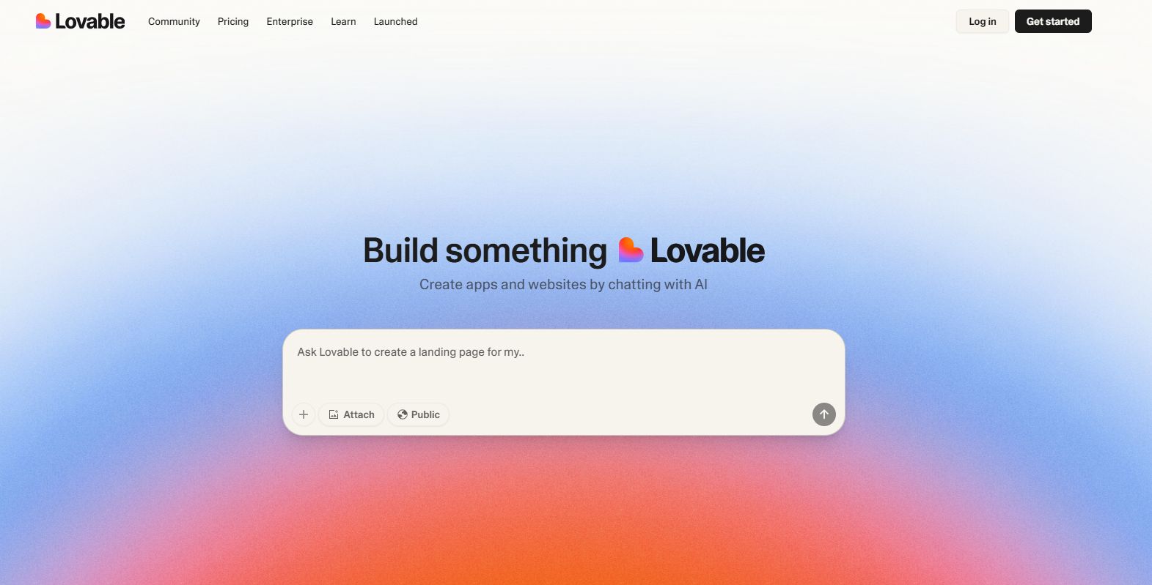

Lovable for Building Lightweight Apps
Hands‑on workshop with Lovable.dev

Slide 2
Agenda
This session will teach you how to work with Lovable responsibly, confidently, and creatively.
Background and Company
Core Features
Base44 vs Competitors (i.e. Lovable, Bolt)
Pricing Overview and Usage Limitations
Recommendations - For which use-cases to use and when prefered not to

Slide 3
Lovable is an AI-powered platform for developing fullstuck web applications without any coding experience.

Slide 4



Core Features of Lovable
Natural Language Input
Full-Stack Generation
Instant Deployment
Describe your app idea conversationally, just as you would explain it to a colleague.
Automatically creates UI components and workflows without requiring you to write a single line of code.
Provides relatively easy-to-use guides for backend implementations (i.e. database connection, authentication, payment, etc.)
Apps are hosted and deployed immediately

Slide 5
Much Bigger Company then Base 44
Have lots of guides, community examples, etc.

Slide 6
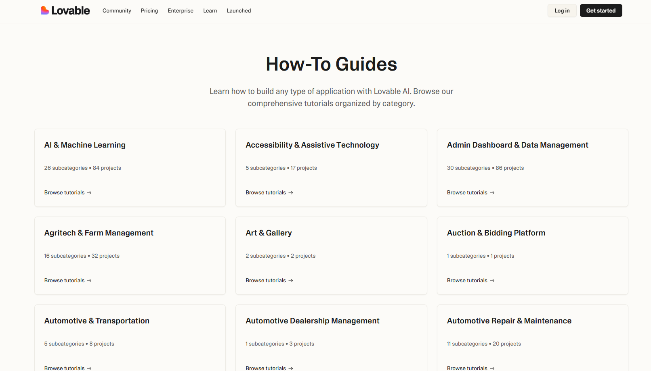
What can you develop with it? Explore their detailed ‘How-To’ Guides

Slide 7
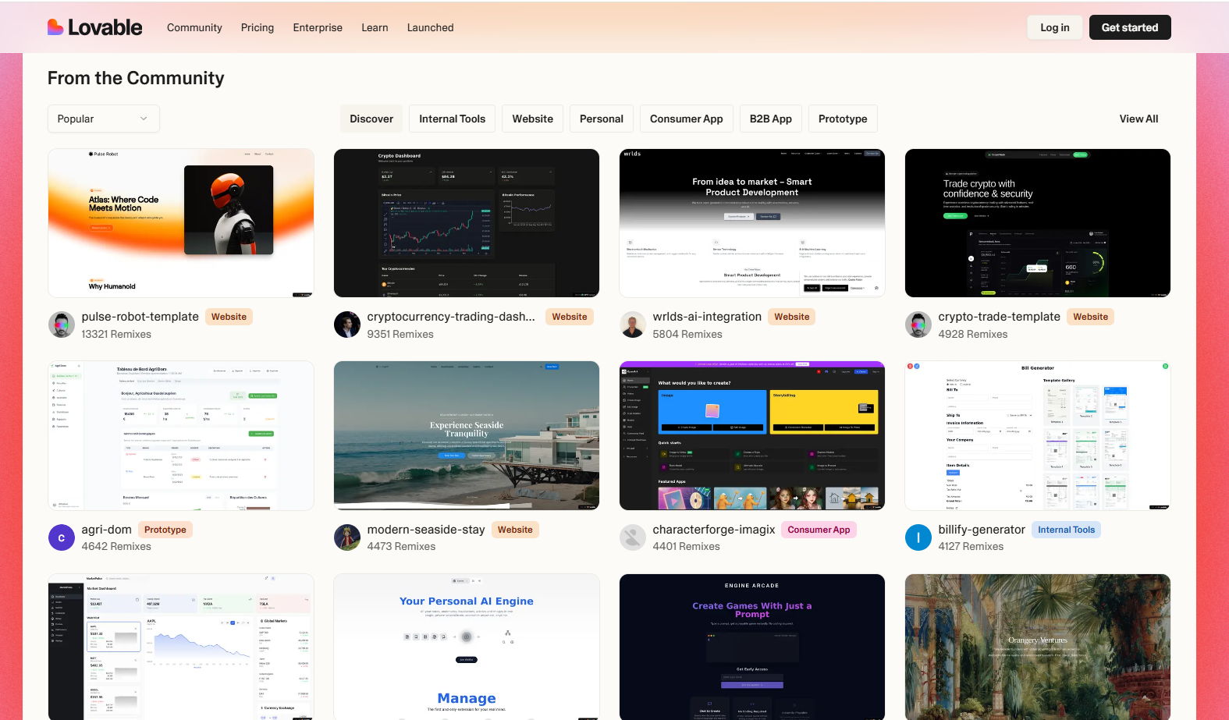
What can you develop with it? Explore community ideas..!

Slide 8
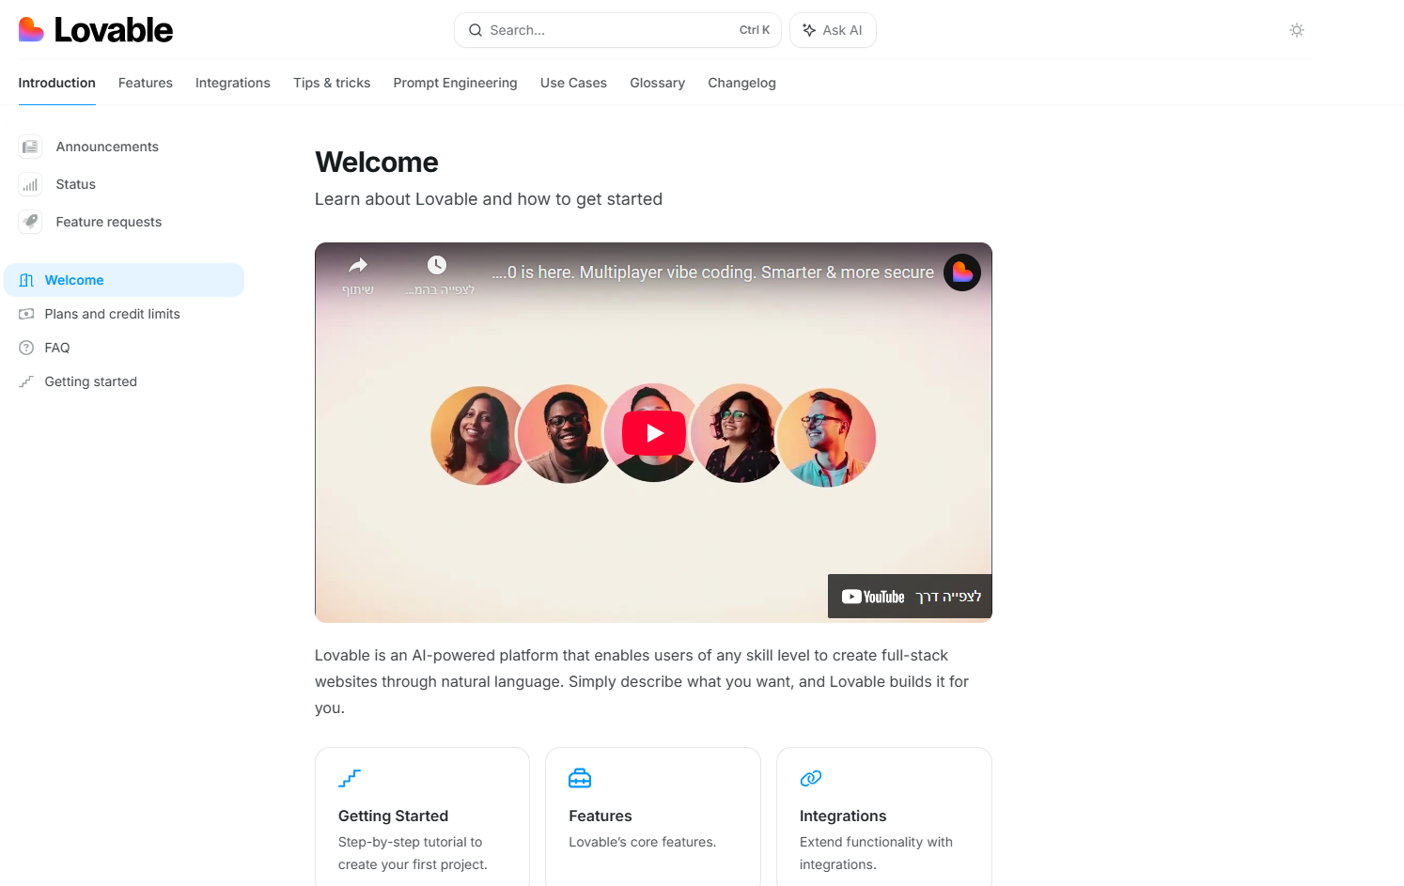
Lovable Academy

Slide 9

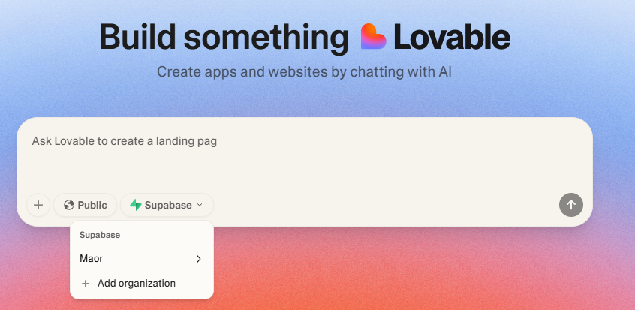
Lovable Backend setup and management
Works with Supabase - an open-source backend platform that provides:
A PostgreSQL database
Authentication & user management
APIs for reading/writing data
Real-time updates & storage features
** press on the picture to learn more about
the integration!

Slide 10
Lovable vs Competitors
When you build an app in Lovable, you often need:
A database to store data (users, products, content)
A login/signup system
Backend logic (e.g., fetch user-specific data)
Instead of building this from scratch, Lovable connects your app to Supabase behind the scene.
You need to create an account and open a project in Supabase, and then you go back to Lovable and connects it to your app

Slide 11
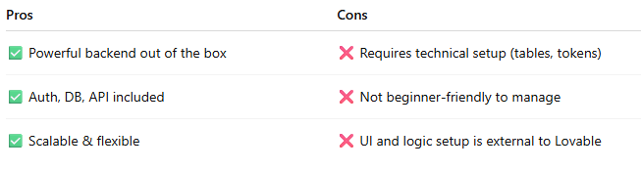
Lovable vs Competitors
Supabase is a powerful backend management, BUT not fully integrated into Lovable’s visual interface. This is in contrast to Base44, which creates for you all of the backend logic inside the platform.
In Lovable you must manage data structure, permissions, and auth separately via the Supabase dashboard, which can create confusion for non-technical user.

Slide 12
Lovable vs Competitors
 | Lovable | Base44
Ease of Use | ⭐⭐ – Simple visually, but setup (e.g., Supabase) can feel clunky/confusing | ⭐⭐⭐⭐ – Intuitive, streamlined flow with built-in DB, auth, and payments
Free plan credits | 5 credits per day, 30 per month | 7 credits per day, 25 per month
AI integration (inside the app you build) | Manually connect API (i.e. OpenAI API for ChatGPT services inside your app) | Have limited integration credits an only when exceeded needs to connect API
Learning Curve | 🎢 Low at first, but quickly becomes confusing with external tools | 📈 Smooth – Minimal backend setup, great for practical builders
Backend Management | ❌ Relies on Supabase (external, technical) | ✅ Fully integrated – DB, auth, payments, roles, all in one dashboard
Auth & User Management | ❌ Not built-in – Needs third-party workarounds (i.e. via Supabase connection to Google authentication) | ✅ Built-in – Automatic user system, login/signup ready out of the box
Database Handling | ❌ Not built-in – Needs third-party workarounds (i.e. via Supabase) | ✅ Seamless – Auto-setup DB with easy data modeling and live editing
Payments Integration | ❌ Not built-in – Needs third-party workarounds (i.e. via Supabase connection to Stripe) | 💳 Native – Stripe and payments setup included and pre-wired
Code control | No control from Lovable in the free plan, only Export to Git | No control in the free plan (can view), no Export to Git

Slide 13
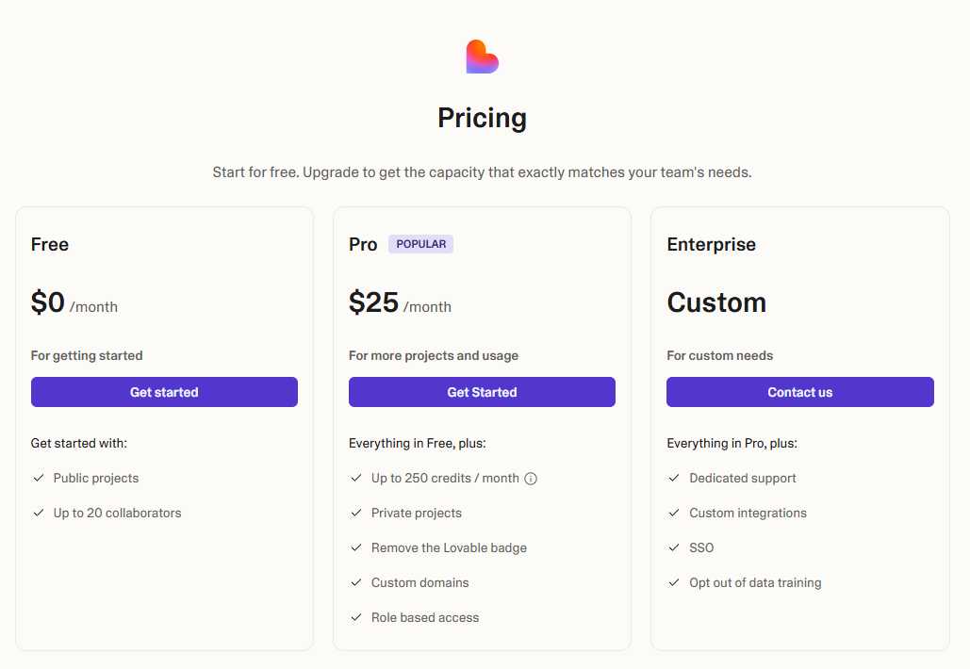
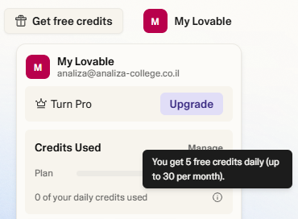
Pricing
In the free plan you get 5 daily credits, up to 30 per month.
Each message costs 1 credit
Don’t have built-in AI credits - must integrate API for use generative AI within your developed app

Slide 14
When Not to Use...
Despite its benefits, consider alternatives in these scenarios:
Projects Requiring Full Control
Massive Enterprise Applications
Limited Long-Term Budgets
Experienced developers needing complete code control prefer tools like Cursor.Applications requiring advanced performance optimizations need custom development.
Systems with thousands of users and strict security requirements need enterprise solutions.Complex integrations with legacy systems may prove challenging.
Organizations avoiding recurring payments should seek one-time solutions.Notification features may incur unexpected costs.

Slide 15
Today
Tour of the Lovable interface.
How to build a working app with user input, saved data, and dynamic screens.
How to use flows (logic engine), the database, and API integrations.
Build a full app step-by-step together with your instructor.

Slide 16
Lovable Demonstration
"FormFlow" app – Build-Your-Own Form and Analyze Submissions

